Slide 1
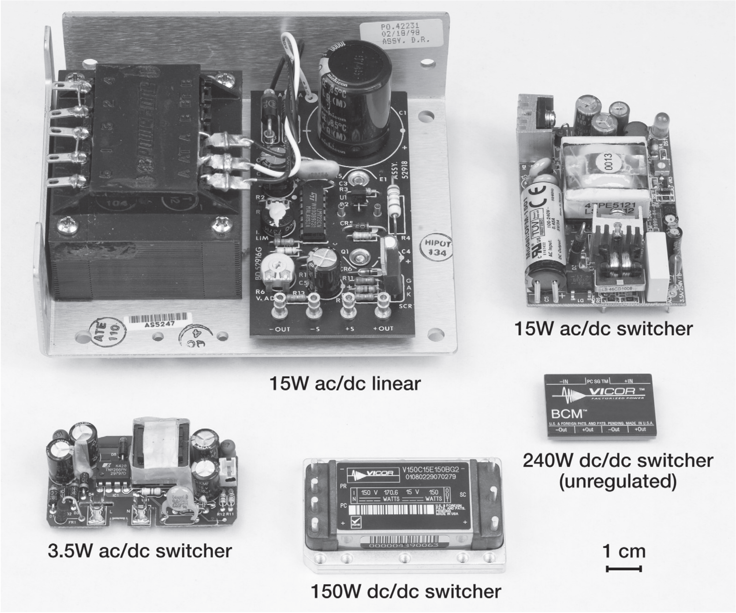
Mini-Project
Regulated Power Supply Basics

Slide 2
Grading:
lab work | Grade distribution
Team Work | 3pt
Attendance | 2pt
Final Results | 5pt
Total Points | 10

Slide 3
Outline
PS BLOCK Diagram
Fuse Switch
Stepdown Transformer
Rectifier
Storage Capacitor
Linear Regulator
Design Example
Staring with PS Specs.
Selecting Right Components to Meet These Specs.

Slide 4
Introduction
Nearly all electronic circuits, such as PCs, Laptops and Phones, require one or more sources of stable dc voltage.
When we design PS we are interested in three major elements Power efficiency , Cost, and Reliability.
There are many types of PS will well study only a simple regulated power supply.

Slide 5
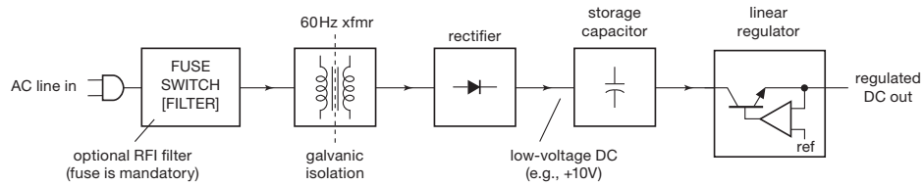
PS BLOCK Diagram
Fuse Switch
Stepdown Transformer
Rectifier
Storage Capacitor
Linear Regulator
Notes:
وظيفة السوفت وير انى اكتب فيه أوامر للهاردوير بتاعى (برنامج او سكتش) وبعد كده ارفع الأوامر دى على الkit بتاعتى
وظيفة الهارد وير انه ينفذ الأوامر اللى انا كتبتها في السكتش بتاعى

Slide 6
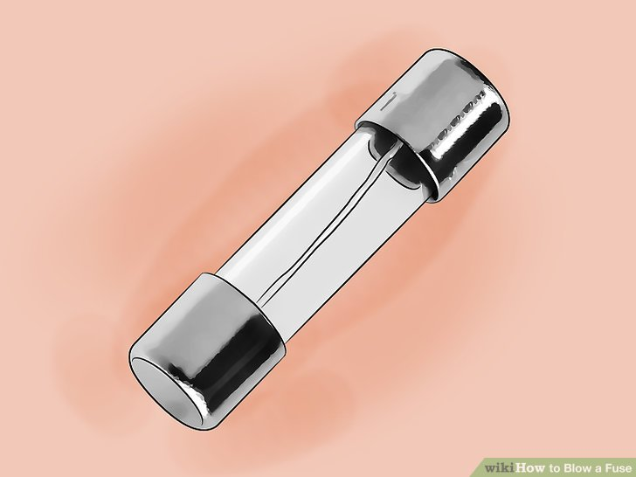
Fuse Switch
A fuse “blows out” by melting a metallic link, for steady currents larger than its rating.
It is used to protect the circuit when C.S Failures occurs

Slide 7
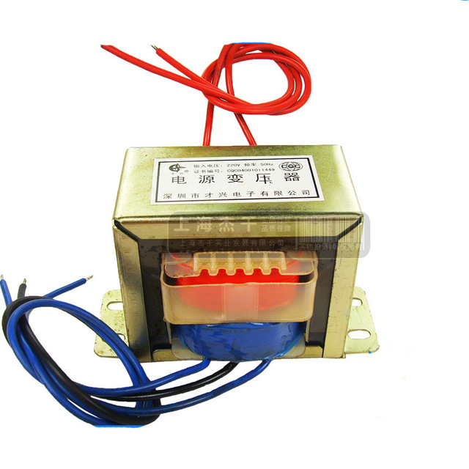
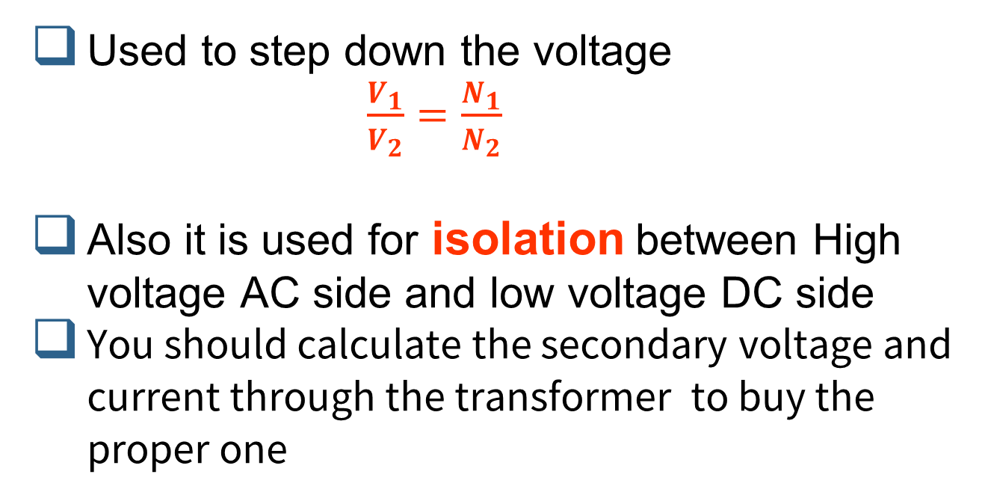
Transformer
Used to step down the voltage $\frac{V_{1}}{V_{2}}=\frac{N_{1}}{N_{2}}$
Also it is used for isolation between High voltage AC side and low voltage DC side
You should calculate the secondary voltage and current through the transformer to buy the proper one

Slide 8
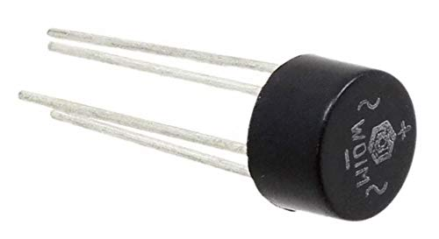
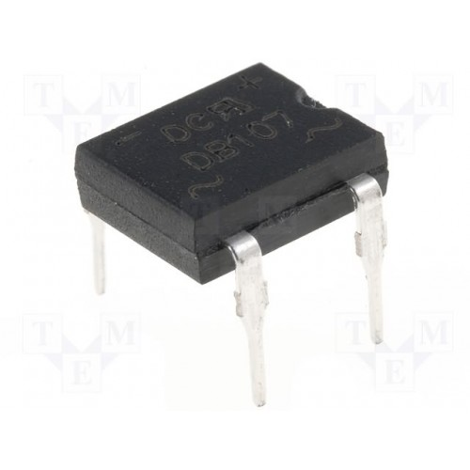
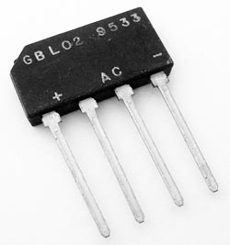
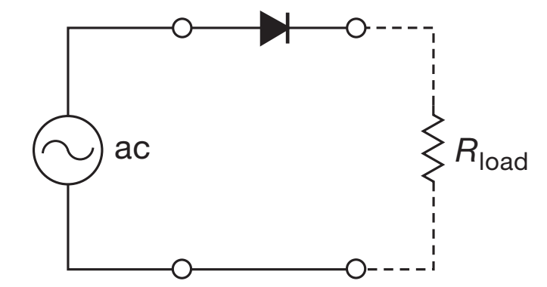
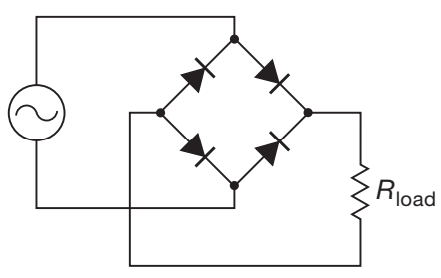
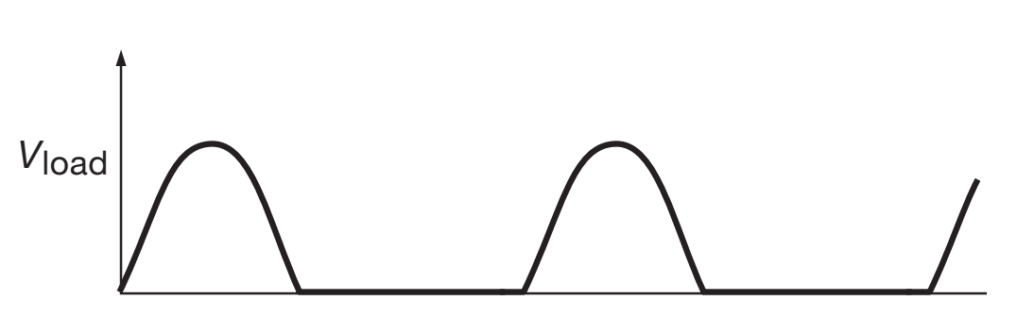
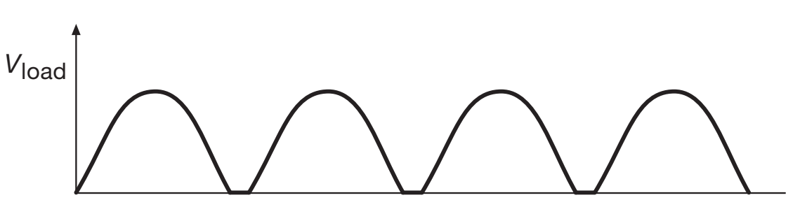
Rectifier
A Rectifier changes AC to DC; this is one of the simplest and most important applications of Diodes.
The simplest circuit is shown in below (half-wave rectifier ) The “ac” symbol represents a source of ac voltage; in electronic circuits it is usually provided by a transformer, powered from the ac power line
Another rectifier circuit, a (full-wave bridge)shown below

Slide 9
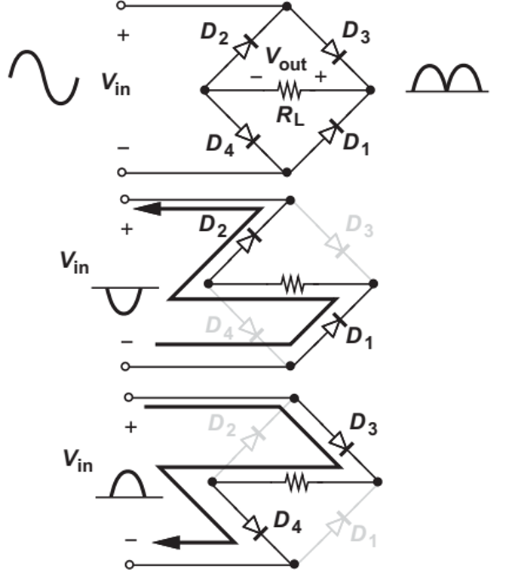
Rectifier
A Bridge rectifier passes the negative half cycles through D1 and D2 with a sign reversal and the positive half cycles through D3 and D4 with no sign reversal.
Also remember that the beak voltage of the output is reduced by 2VDon because, always there are two diodes are always in series with the input.
Rectifiers don’t not produce a useful output. Unlike a battery, the rectifier generates an output that varies considerably with time and cannot supply power to electronic devices.
We must therefore attempt to create a constant output.
Fortunately, a simple modification solves the problem.

Slide 10
How to choose a Rectifier
There are two major parameters you should consider when choosing a rectifier :
Maximum Current Rating
Maximum peak inverse voltage (PIV):
for H.W choose diode with : PIV > 2Vp
for F.W choose diode with : PIV > Vp
You can get these values for a typical diode from what is called diode datasheet!!!
if you used wrong components your circuit will have high chance of failure!!!!.

Slide 11
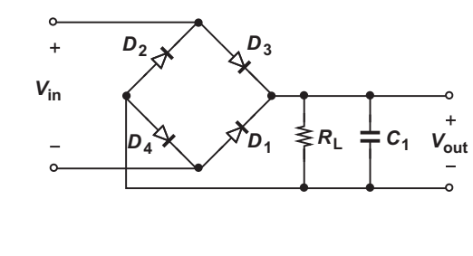
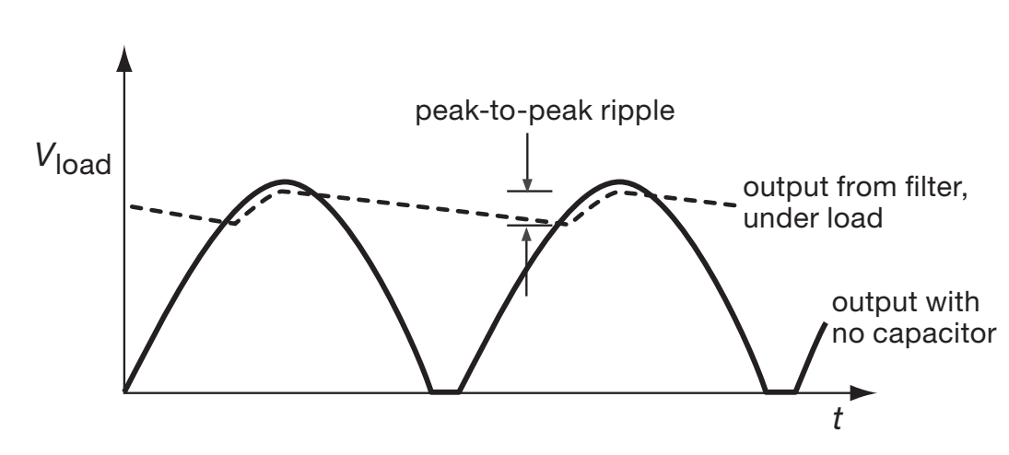
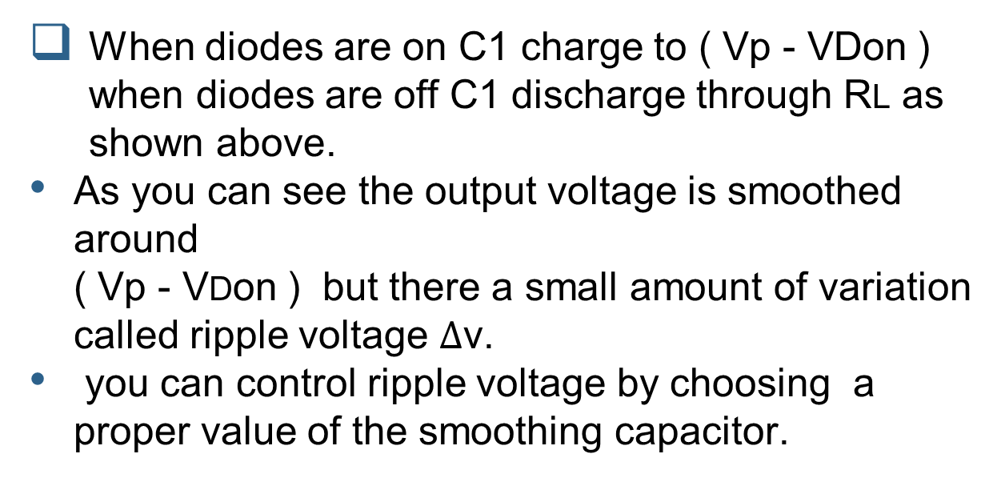
Filtering Capacitor
When diodes are on C1 charge to ( Vp - VDon ) when diodes are off C1 discharge through RL as shown above.
As you can see the output voltage is smoothed around ( Vp - VDon ) but there a small amount of variation called ripple voltage $Δ$v.
you can control ripple voltage by choosing a proper value of the smoothing capacitor.

Slide 12
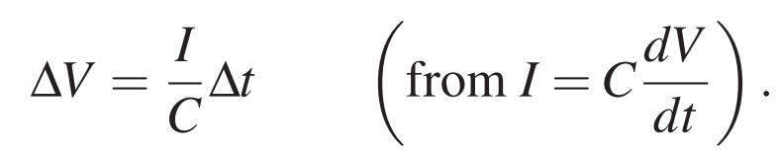
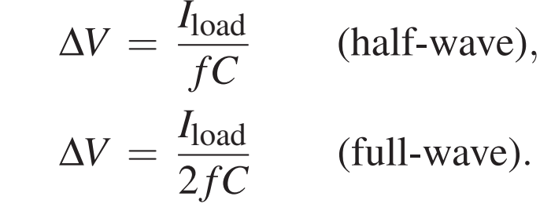

Calculating Ripple Voltage
Note that $Δ$v depends on Iload and C so for large Iload you should choose large C to get small ripple.

Slide 13
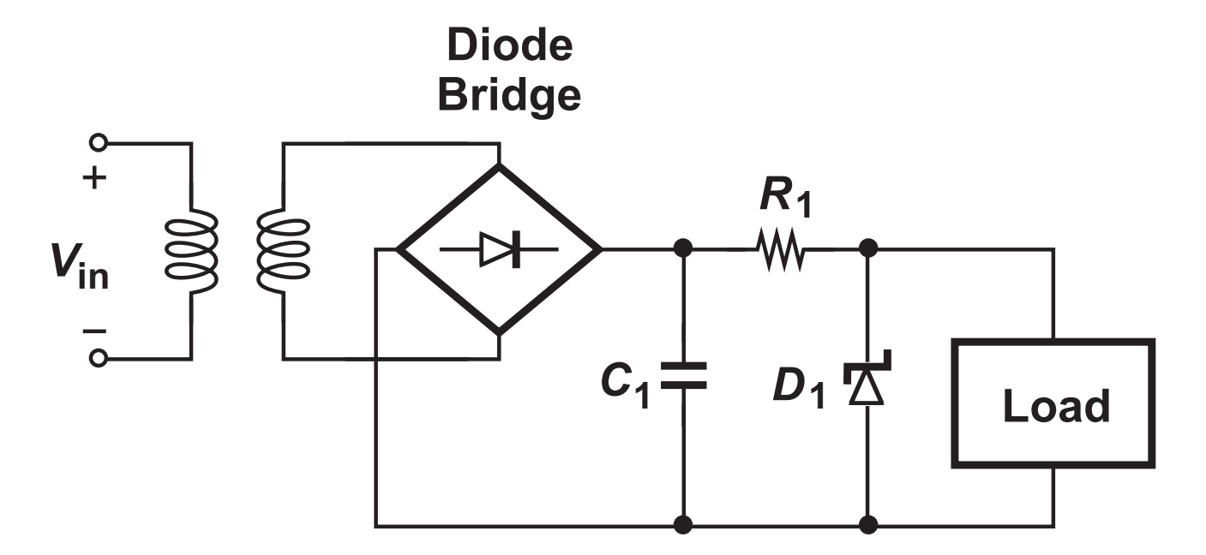
Voltage Regulation
The adaptor circuit studied above generally proves inadequate. Due to the significant variation of the line voltage, the peak amplitude produced by the transformer and hence the dc output vary considerably, possibly exceeding the maximum level that can be tolerated by the load.
the finite output impedance of the transformer leads to changes in Vout if the current drawn by the load varies.
For these reasons, the circuit studied before is often followed by a “voltage regulator” so as to provide a constant output voltage

Slide 14
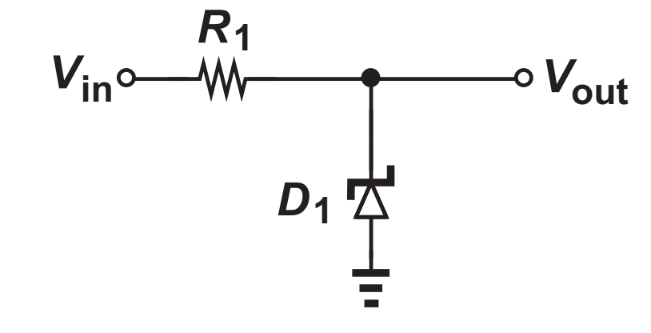
Zener Diode
Zener diode works in revers region.
When input voltage increases above Vz it starts to conduct and can be replace with battery of Vz.
Zener diode is Characterized by its maximum Power dissipation Pmax and its zener voltage Vz.
The maximum current a zener can tolerate Imax: Izmax = Pmax/Vz
To increase the maximum current you can use more than one zener in parallel.
The resistor R1 is used to control the value of maximum current .

Slide 15
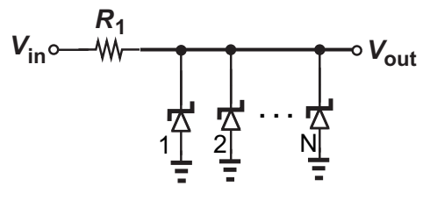
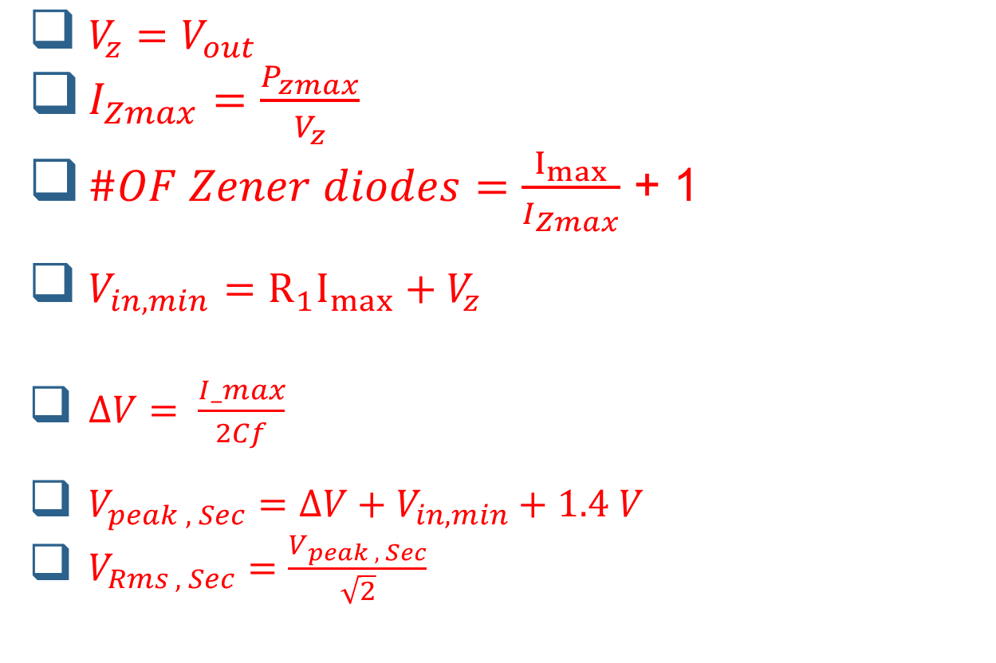
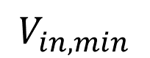
Zener Diode
$$V_{in,min}$$
$V_{z}=V_{out}$
$I_{Zmax}=\frac{P_{zmax}}{V_{z}}$
$\#OF Zener diodes=\frac{I_{max}}{I_{Zmax}}$ + 1
$V_{in,min}={R_{1}I}_{max}+V_{z }$
$ΔV= \frac{I_max}{2Cf}$
$V_{peak , Sec}=ΔV+V_{in,min}+1.4 V$
$V_{Rms , Sec}=\frac{V_{peak , Sec}}{\sqrt{2}}$

Slide 16
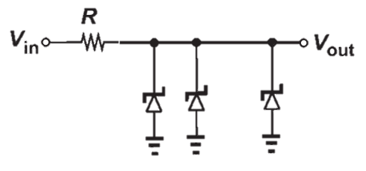
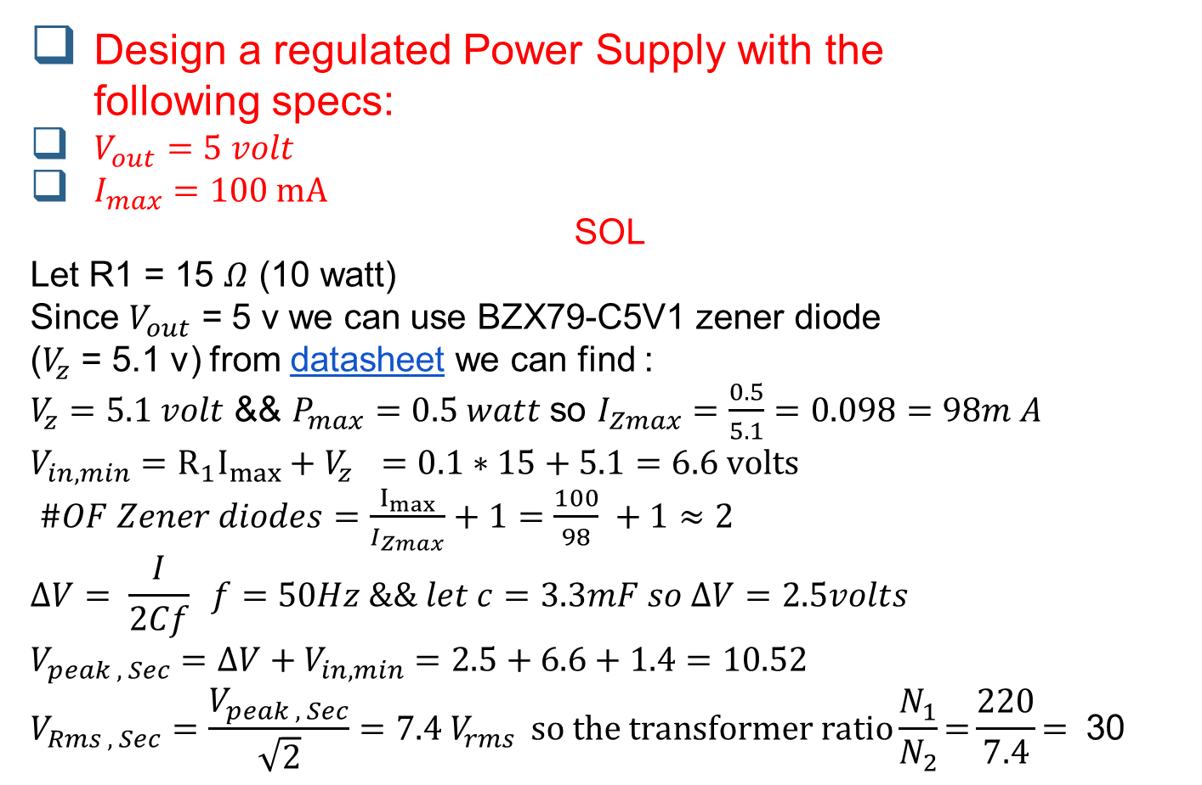
Design Example
Design a regulated Power Supply with the following specs:
$V_{out}=5 volt$
$I_{max}=100 mA$
SOL
Let R1 = 15 $Ω$ (10 watt)
Since $V_{out}$ = 5 v we can use BZX79-C5V1 zener diode ($V_{z}$ = 5.1 v) from datasheet we can find :
$V_{z}=5.1 volt$ && $P_{max}=0.5 watt$ so $I_{Zmax}=\frac{0.5}{5.1}=0.098=98m A$
$$V_{in,min}={R_{1}I}_{max}+V_{z }=0.1∗15+5.1=6.6 volts$$
$\#OF Zener diodes=\frac{I_{max}}{I_{Zmax}}+1=\frac{100}{98} +1≈2$
$$ΔV= \frac{I}{2Cf} f=50Hz \&\& let c=3.3mF so ΔV=2.5volts$$
$$V_{peak , Sec}=ΔV+V_{in,min}=2.5+6.6+1.4=10.52$$
$$V_{Rms , Sec}=\frac{V_{peak , Sec}}{\sqrt{2}}=7.4 V_{rms } \text{so} \text{the} \text{transformer} \text{ratio}\frac{N_{1}}{N_{2}}\text{=}\frac{220}{7.4}\text{= } \text{30}$$

Slide 17
How to get -ve supply voltage?
To get –ve supply voltage just swap the GND with Vout reference points

Slide 18
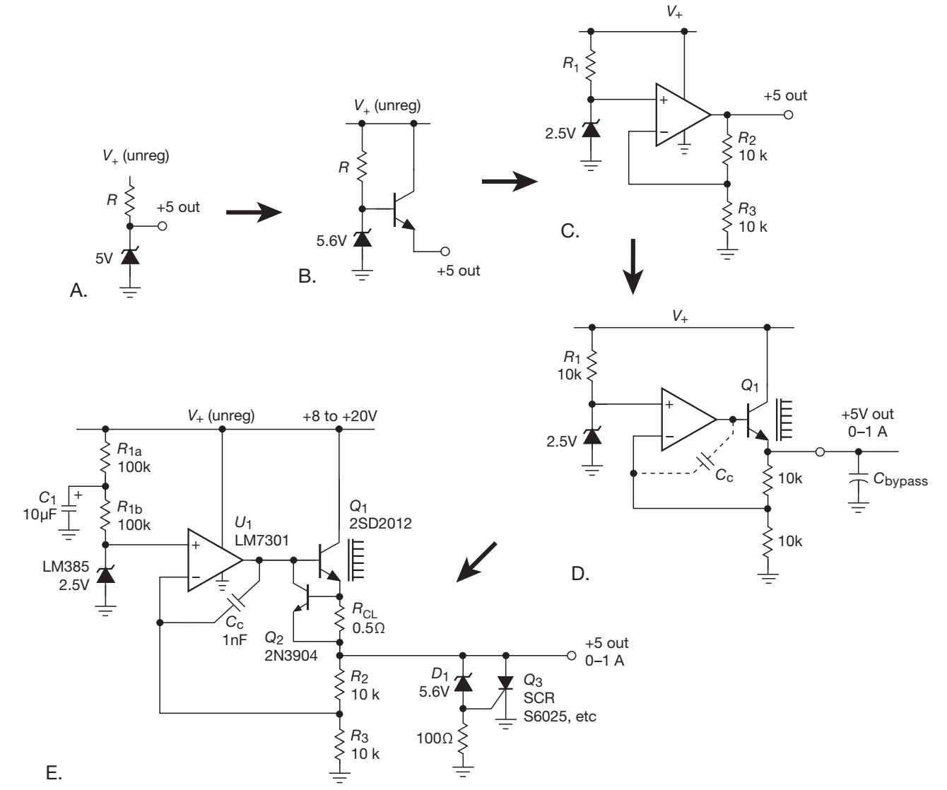
What Next????
Here is a Tutorial from zener to series-pass linear regulator

Slide 19
References :
Art of Electronics 3rd Edition by Paul Horowitz, Winfield Hill
( chapter 1 section 1.6 ) && ( chapter 9)
Fundamentals of microelectronics 2nd Edition by Behzad Razavi
(chapter 3 sections 3.5.1-3.5.2)

Slide 20
THANKS

